Slide 1
Algorithmic Trading
Tharun Polamarasetty
Under the guidance:
Graham Carroll
(Vice- President, QMS Capital Management LP)

Slide 2
Securities
Trading Signal
Algorithm
Portfolio trading
Screen through 700 US Equities with 7 filter layers
Apply nonparametric Jump Model(Lee,Mykland)
Calculate L statistic for K=16 to offset from volatility jumps
Calculate T statistic, J Statistic
Trading Signal: Filter for signicance level 1%
Improvement: Pass it through EPS(quarterly actual) - EPS(quarterly census estimate)
Current Price

Slide 3
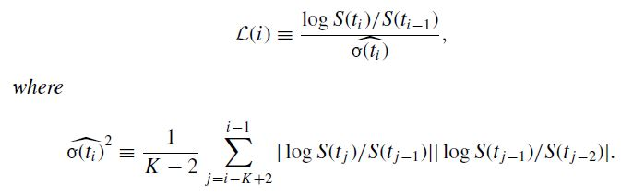
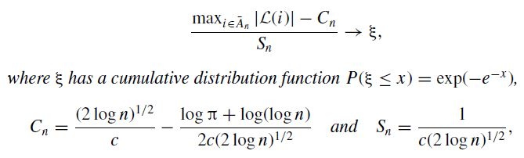
L Statistic:
Selection of rejection region:
P(ξ ≤ β∗) = exp(−e−β∗ ) = 0.99, Therefore, if β∗> 4.6001
β∗ = −log(−log(0.99))= 4.6. then we reject the hypothesis of no jump at ti .

Slide 4
Strategy Performance

Slide 5
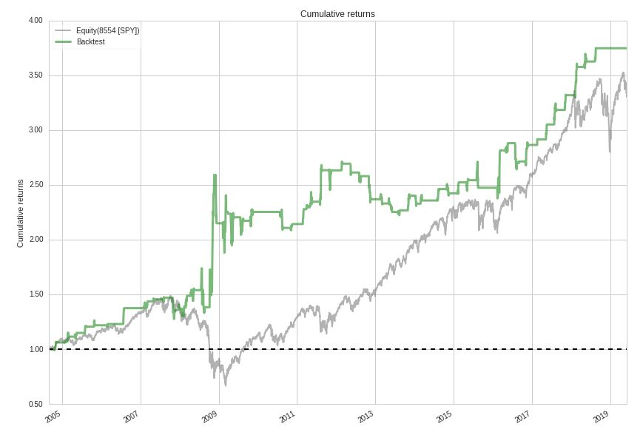
Cumulative Returns

Slide 6
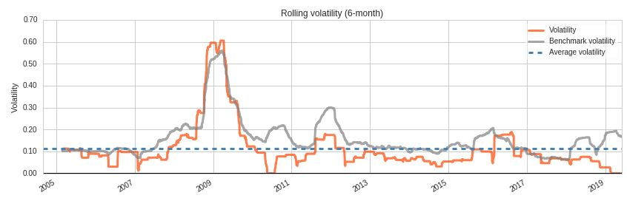

Slide 7
Worst drawdown periods | Net drawdown in % | Peak date | Valley date
0 | 27.37 | 2008-12-04 | 2009-02-23
1 | 23.41 | 2008-07-28 | 2008-08-19
2 | 17.98 | 2012-02-23 | 2013-08-12
3 | 13.49 | 2007-08-10 | 2007-11-12
4 | 8.46 | 2011-08-17 | 2011-11-04

Slide 8
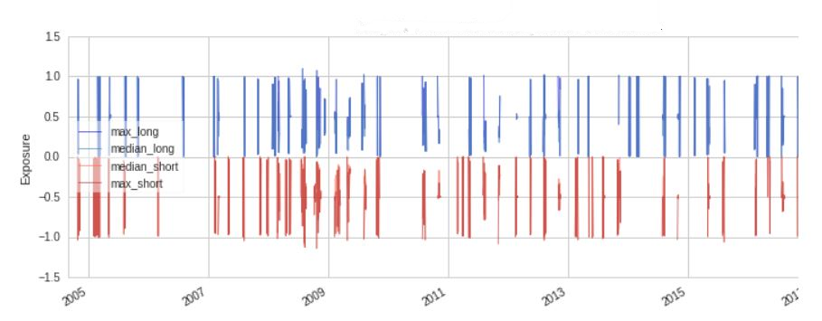
Longs/Shorts position concentration

Slide 9
Top 10 Long positions of all time | Max
FDG-23121 | 109.68%
MER-4796 | 107.30%
X-8329 | 103.22%
PRU-23328 | 102.14%
AIG-239 | 101.87%
OVV-23021 | 101.57%
EQR-9540 | 101.41%
GM-40430 | 101.39%
BAM-21475 | 101.39%
APA-448 | 100.53%
Top 10 Short positions of all time | Max
SLF-21328 | -113.76%
TD-15596 | -113.68%
AGU-12856 | -112.27%
RIG-9038 | -108.25%
AIG-239 | -107.17%
OUBS-7696 | -106.65%
NXY-22247 | -106.05%
APA-448 | -105.99%
MER-4796 | -105.34%
PEAK-3490 | -104.89%

Slide 10
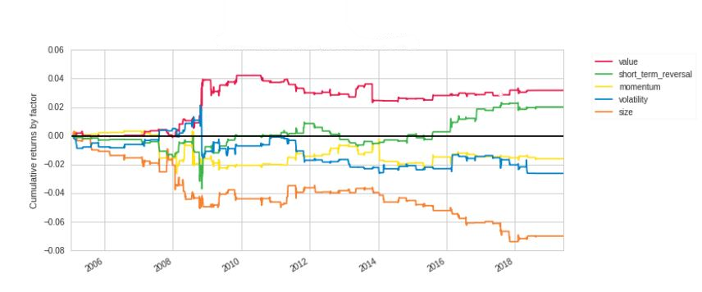
Value based Strategy
Common Styles

Slide 11
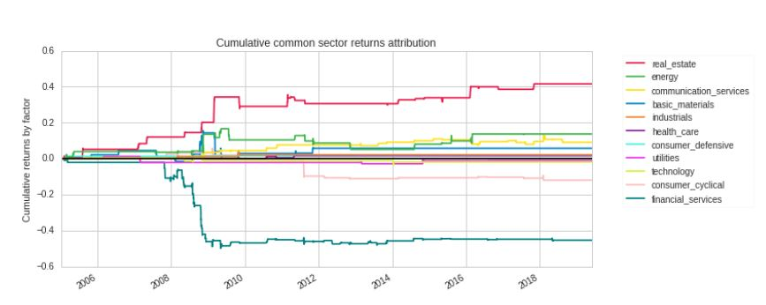
Sector Analysis

Slide 12
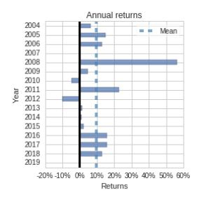

Slide 13
2014 to 2016 performance

Slide 14
Performance During Stress events

Slide 15
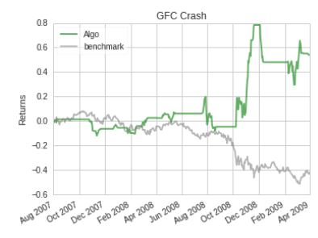
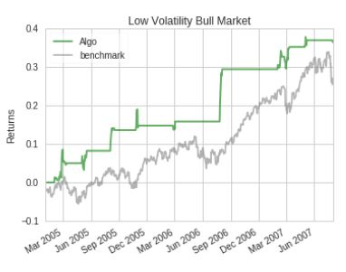

Slide 16
Further improvements
Include short term strategy for 4 months
Invest free capital in S&P500 and exit when needed
Model for weightages instead of passing stocks through filters
Like Fama French model, weightages instead of using filters.
Supervised regression machine learning problem
Portfolio Optimization Techniques

Slide 17
If invested 100,000 in 2005
Algorithm 475,000
S&P 500 425,000
8 months/ year
Projects to 616,000

Slide 18
References
Zhou, Haigang, and John Qi Zhu. "Jump on the Post-Earnings Announcement Drift." Financial Analysts Journal 68, no. 3 (2012): 63-80.
Lee, Suzanne S., and Per A. Mykland. "Jumps in Financial Markets: A New Nonparametric Test and Jump Dynamics." The Review of Financial Studies 21, no. 6 (2008): 2535-563.
Abarbanell, J. S., & Bernard, V. L. (1992). Tests of analysts' overreaction/underreaction to earnings information as an explanation for anomalous stock price behavior. The Journal of Finance, 47, 1181–1207.
https://www.quantopian.com/posts
https://www.quantopian.com/docs/index

Slide 19
Questions

Slide 20
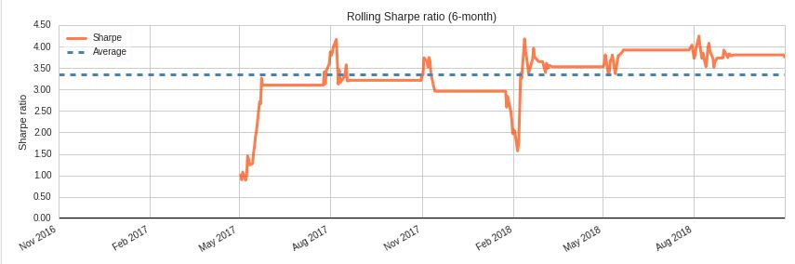
Appendix 1(8+4 month optimized portfolio)

Slide 21
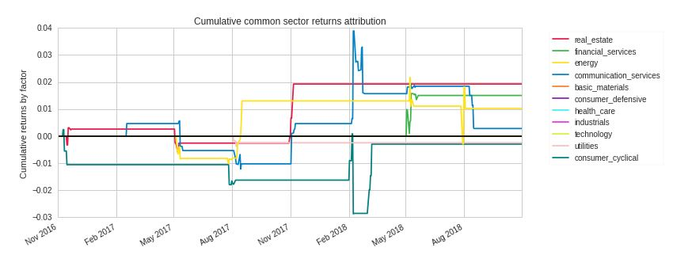
Appendix 1(8+4 month optimized portfolio)

Slide 22
